Slide 1
How toVote
Data 00/00/0000

Slide 2
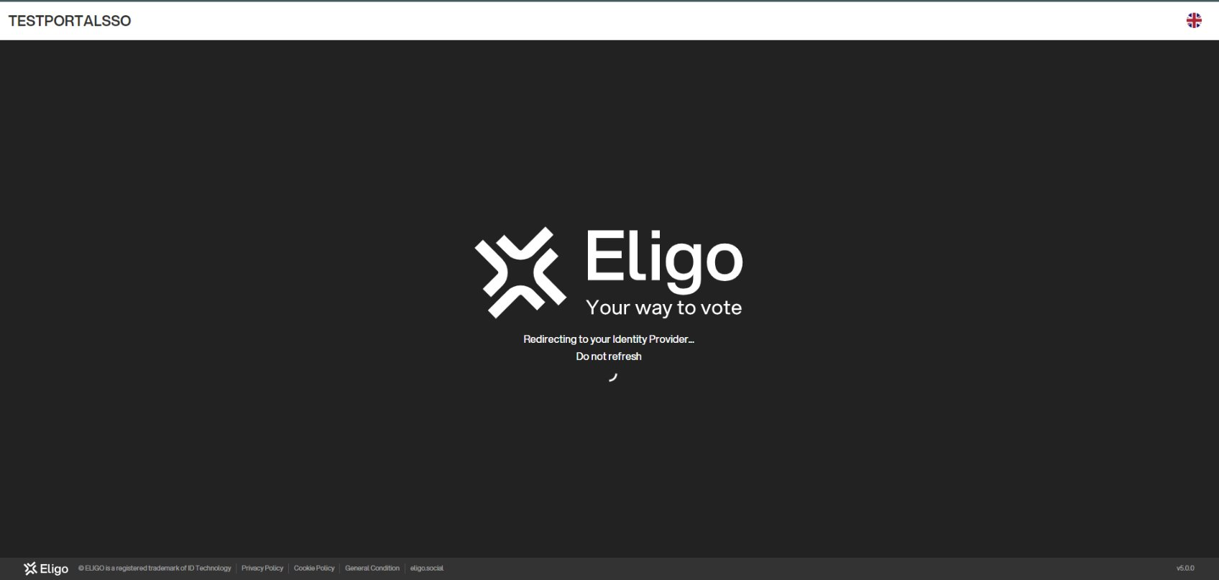
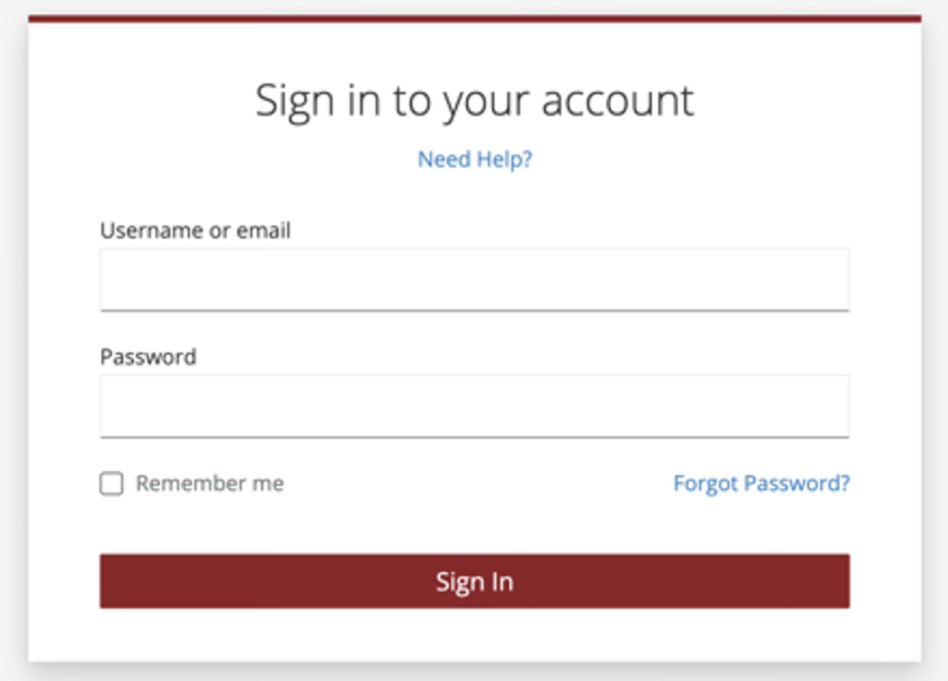
Access with Single Sign On
Your organization will provide the link to access the voting area.
When accessing the voting area, Eligo will redirect you to the authentication system set up by your organization.
You will be asked to authenticate using the method required by your organization.

Slide 3
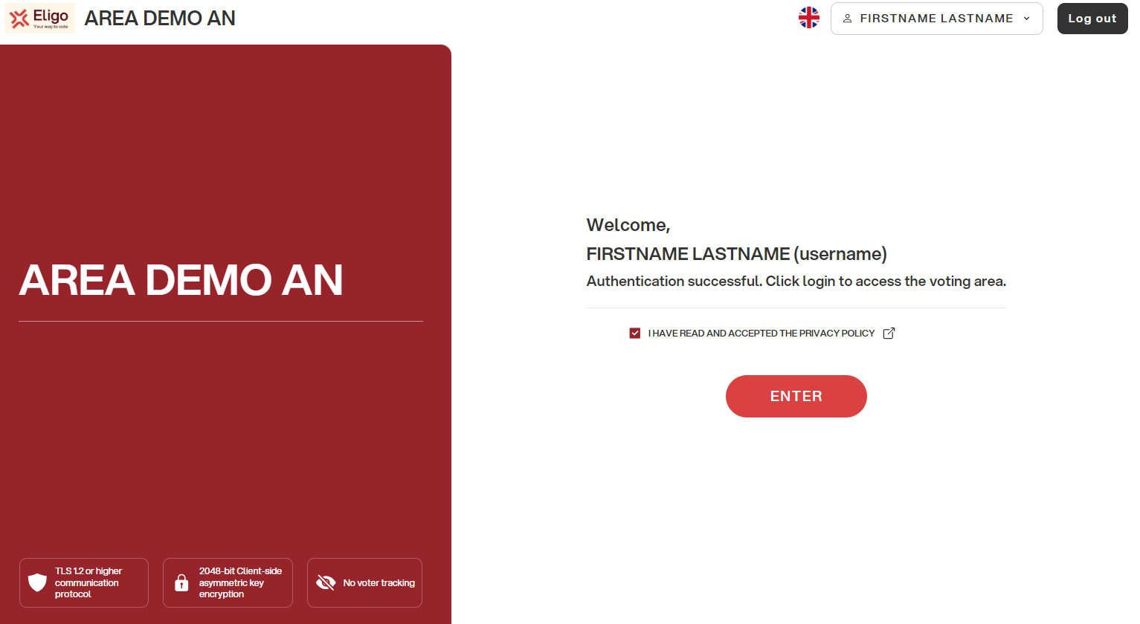
Access the voting area.
If the authentication is successful, you will be redirected to the Eligo access page.
Accept the terms of use and click ENTER to access the voting event.

Slide 4
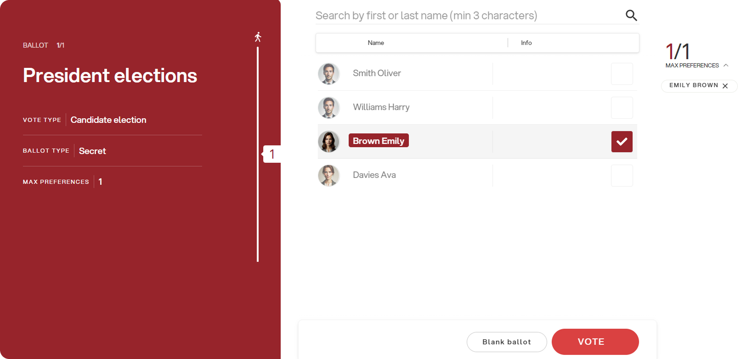
Express your vote.
The ballot(s) to be voted on will be displayed.
To cast your vote, select the button for the chosen candidate to assign preference(s).
Re-press to deselect the candidate and select another candidate.
Click on “VOTE“.

Slide 5
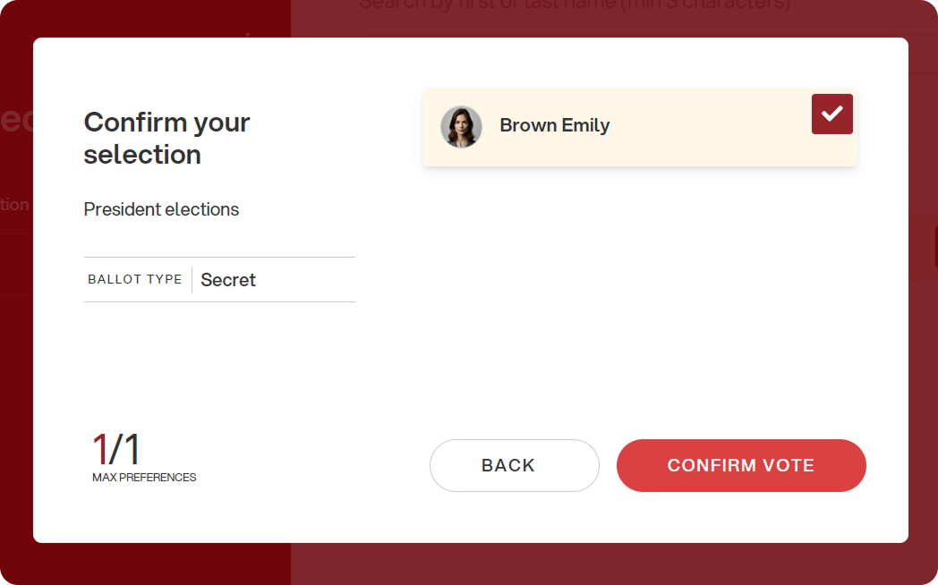
Confirm your vote.
Once the ballot is assigned, the ballot summary page is presented, like the example screenshot at the side.
The ballot is entered into the digital ballot box, only after this step.
By pressing on “Confirm vote," the vote becomes unchangeable.

Slide 6
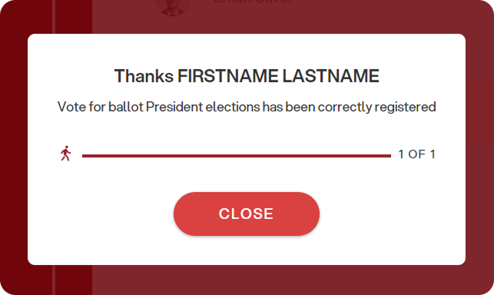
Vote done.
Once the vote is confirmed, a message will appear that the vote has been recorded.
DO NOT close the browser or turn off the PC.
Click “Next Ballot" to end the voting operations or move to the next ballot.

Slide 7
Viale Monte Nero 17, Milano
+02 80511 31
supporto-eligo@evoting.it
Copyright © 2024 ELIGO | ID Technology S.r.l.
P.IVA: 11240660156

