Slide 1

VOTING GUIDE
How to vote with Eligo

Slide 2
Eligo is the secure and intuitive electronic voting platform
The flexible and reliable solution that simplifies voting operations, promoting democratic participation

Slide 3
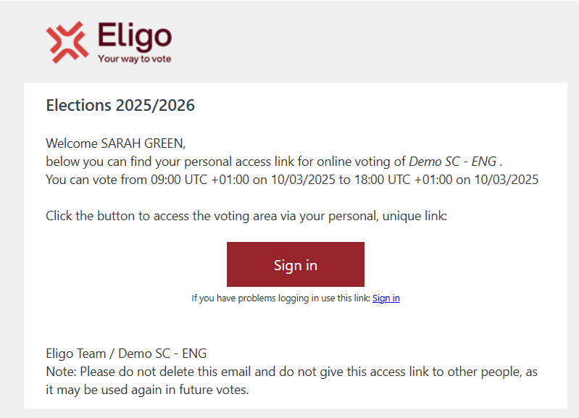
You will receive your link to access the platform by email
Once the voting is open, click on
“Sign in”

Slide 4
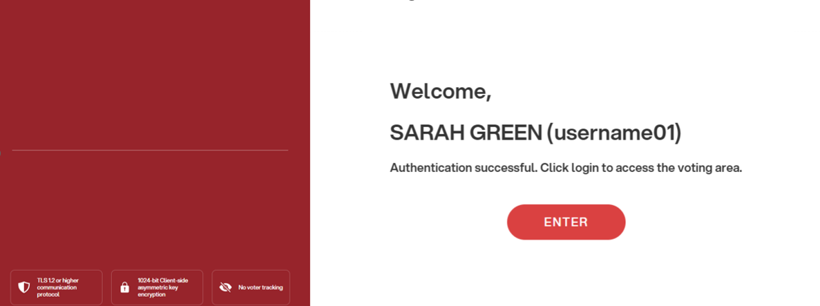
You will be on the voting system login page
Click on “ENTER” to login

Slide 5
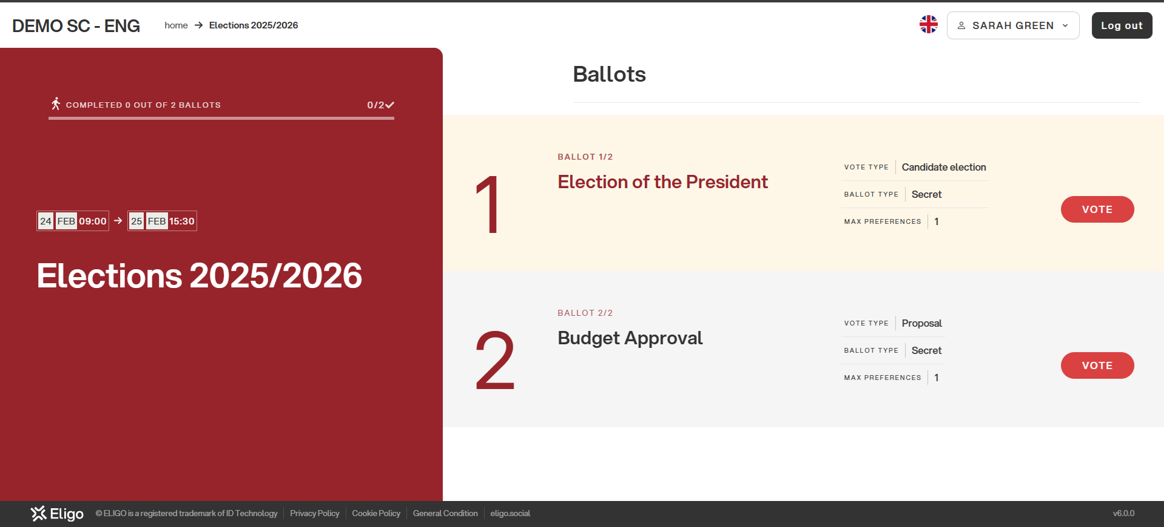
You will observe the digital ballot box, which allows you to view the ballots
Click the “VOTE” button for the initial ballot

Slide 6
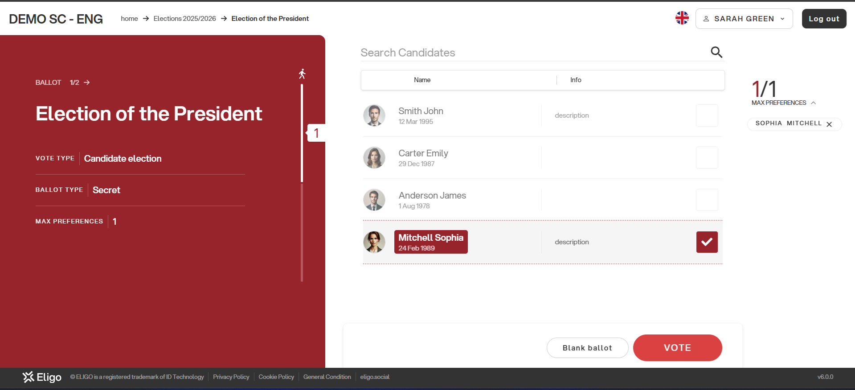
Details regarding the ballot paper
Candidate roster

Slide 7
You must select the box corresponding to your preferred candidate or choose “blank ballot” if you do not wish to indicate a preference
To proceed, click on “VOTE”

Slide 8
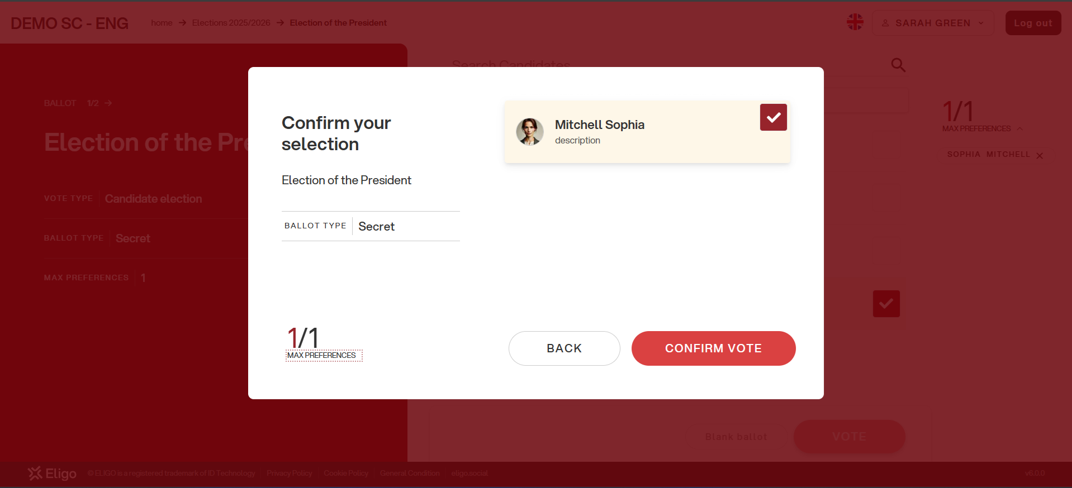
You will arrive at the summary screen
Review your selections
Press “CONFIRM VOTE” to finalize your vote

Slide 9
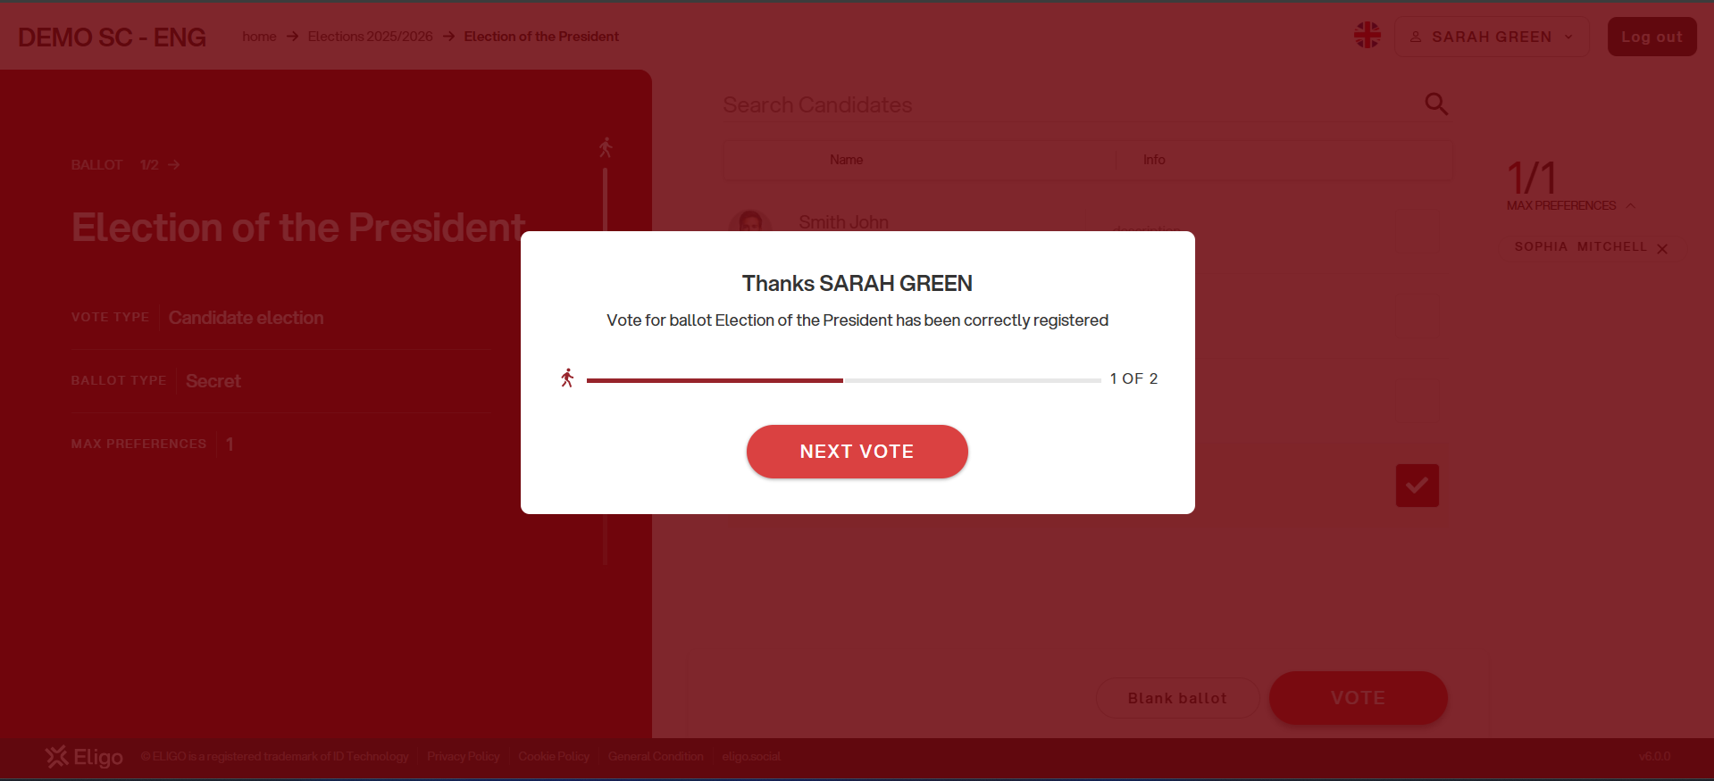
The vote will be recorded in the digital ballot box and will be irreversible
You must click on “NEXT VOTE” to proceed with the voting process
“Close” to conclude the voting process if there are no additional ballots to cast

Slide 10

The online voting platform is offered by Eligo Voting.
Thousands of organizations depend on Eligo for the digital management of remote, in-person, or hybrid voting and meetings.
Copyright © 2026 ELIGO | ID Technology S.r.l.

