Slide 1


VOTING GUIDE
How to vote with Eligo
Assembly

Slide 2

Eligo is a secure and intuitive electronic voting platform
A flexible and reliable solution that simplifies voting processes and supports democratic participation

Slide 3
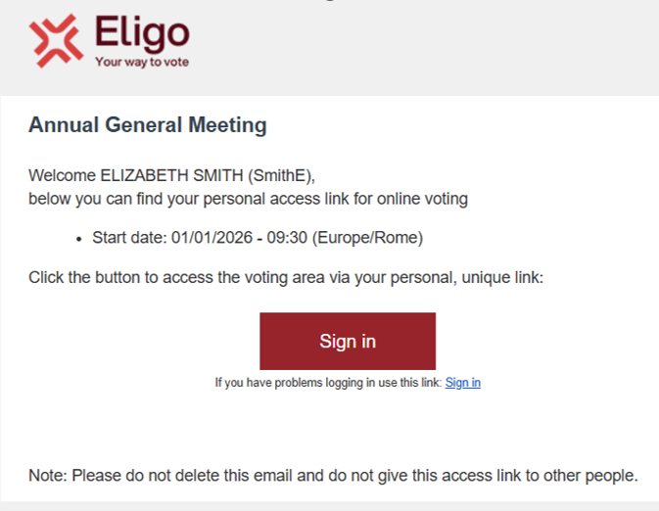
To join the video conference and vote, you will receive an email with the link to access the platform.
Click on “Sign in”.

Slide 4
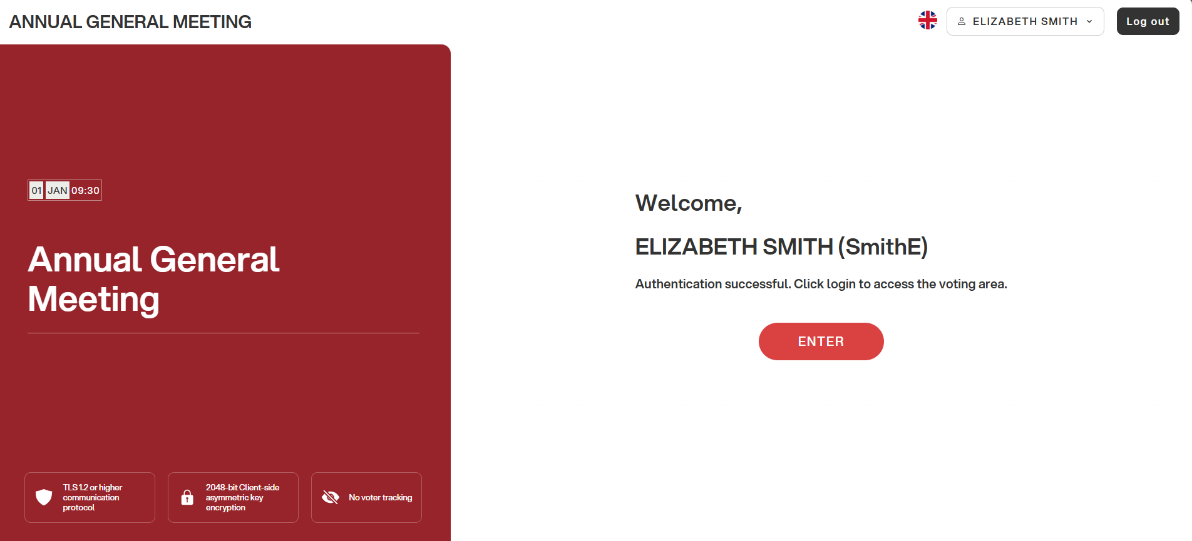
You will be taken to the voting system login page
Click on “ENTER”

Slide 5
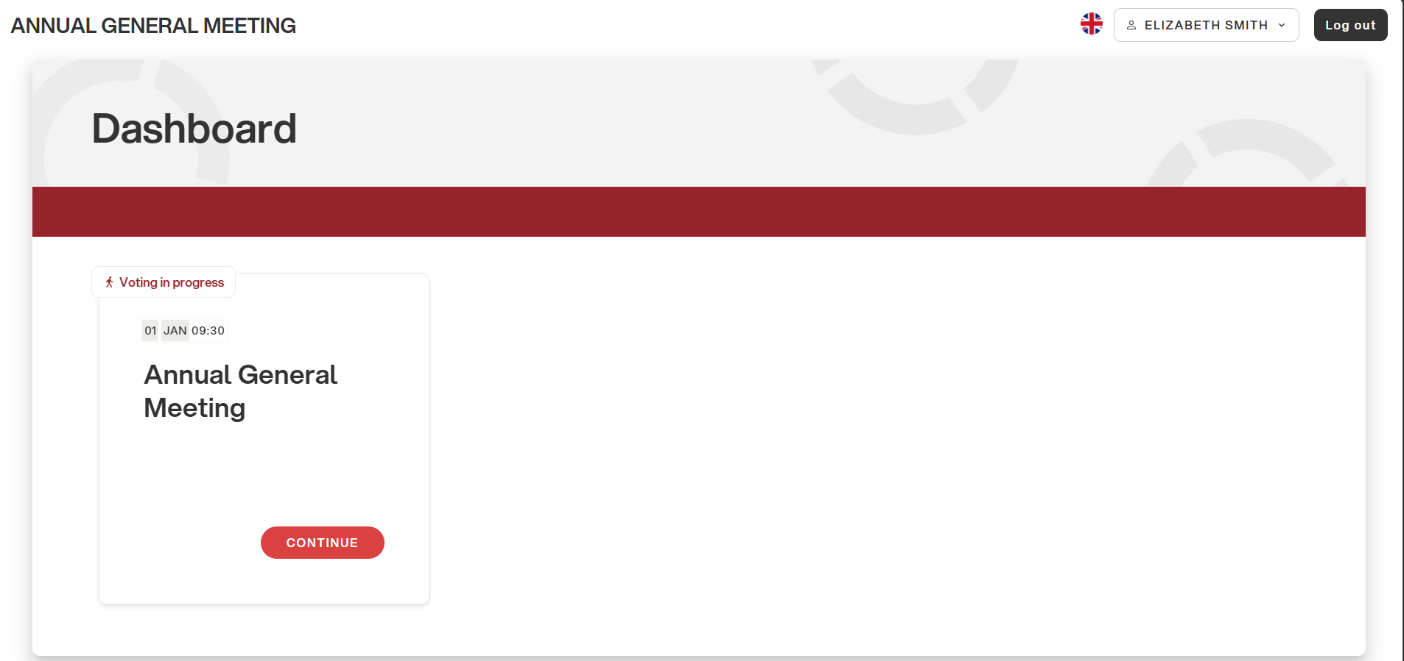
You are now in your personal voting area

Slide 6
When the assembly is open, click on “CONTINUE” to enter

Slide 7
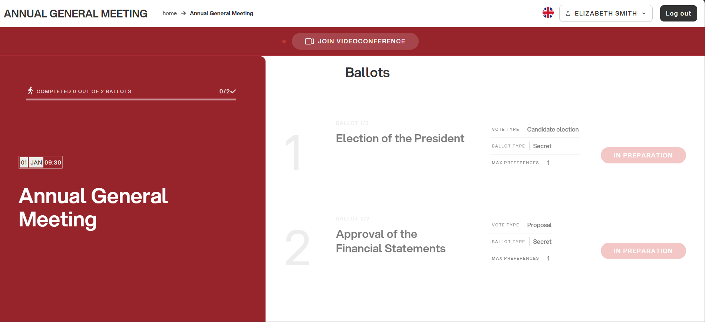
From your area, you can easily access the video conference

Slide 8
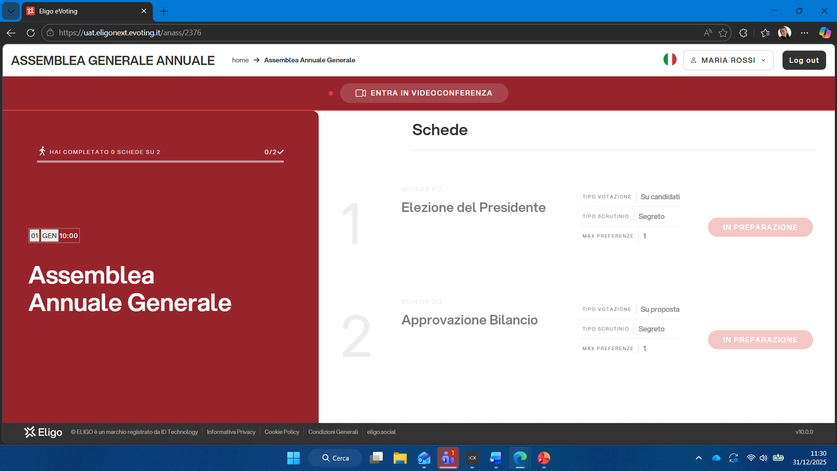
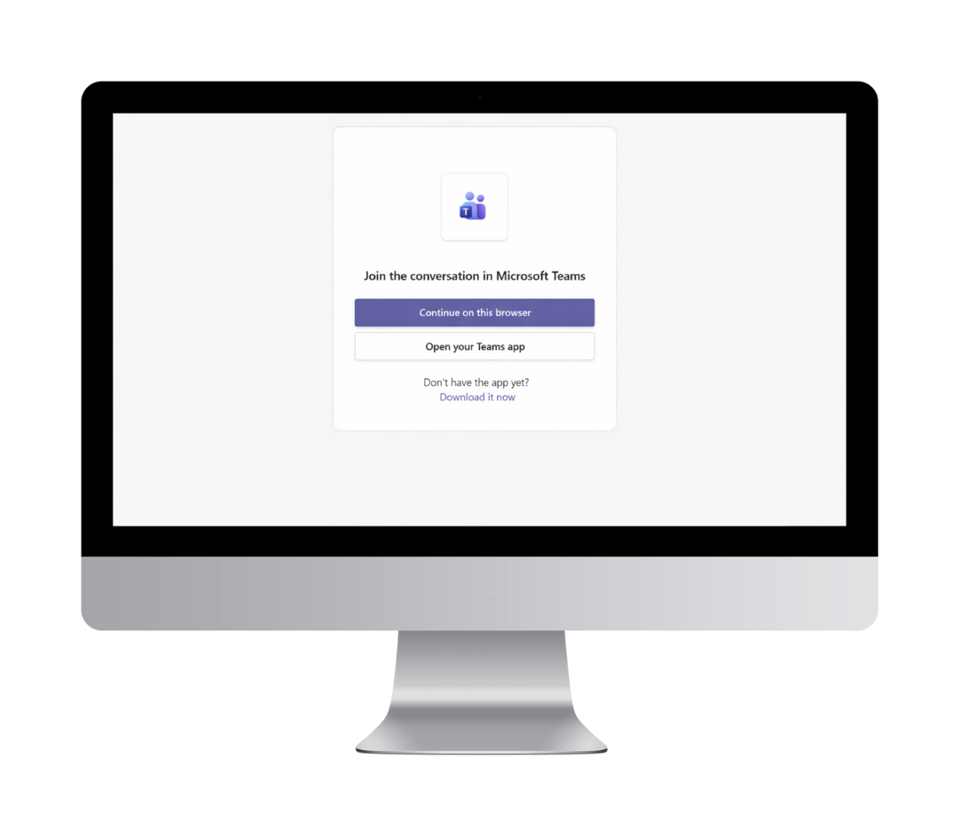
A new page dedicated to the video conference will open

Slide 9
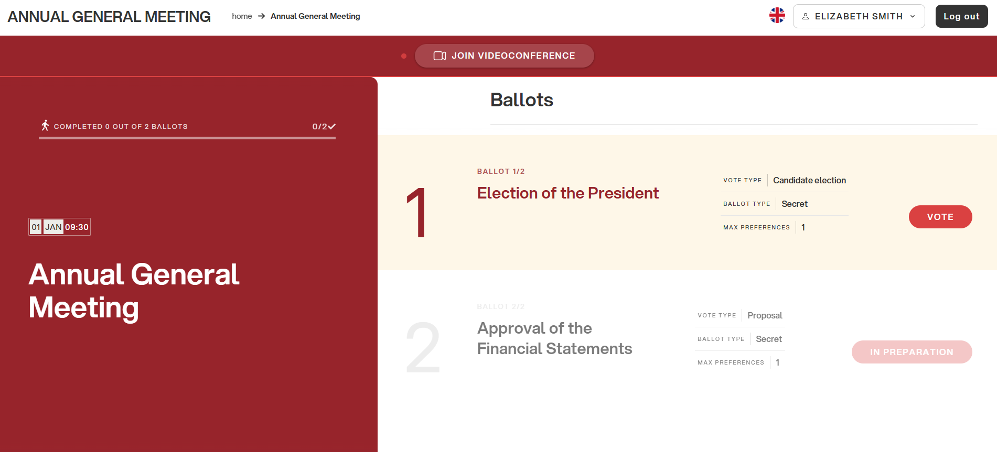
When an agenda item is open for voting, click on “VOTE”

Slide 10
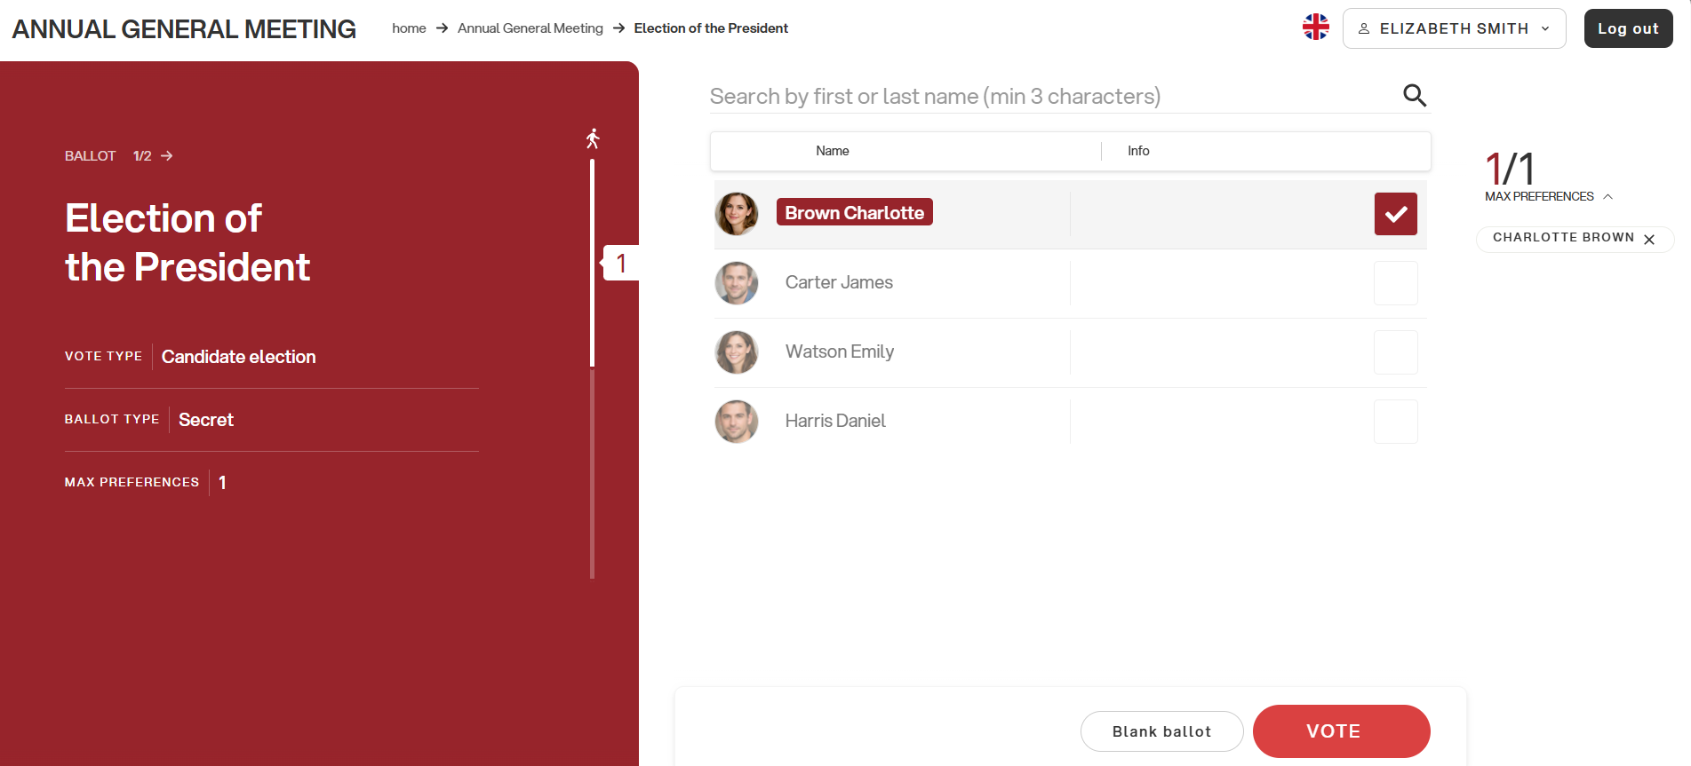
To vote, select the candidate by clicking on the corresponding box.
After making your selection, click on “VOTE” to continue

Slide 11
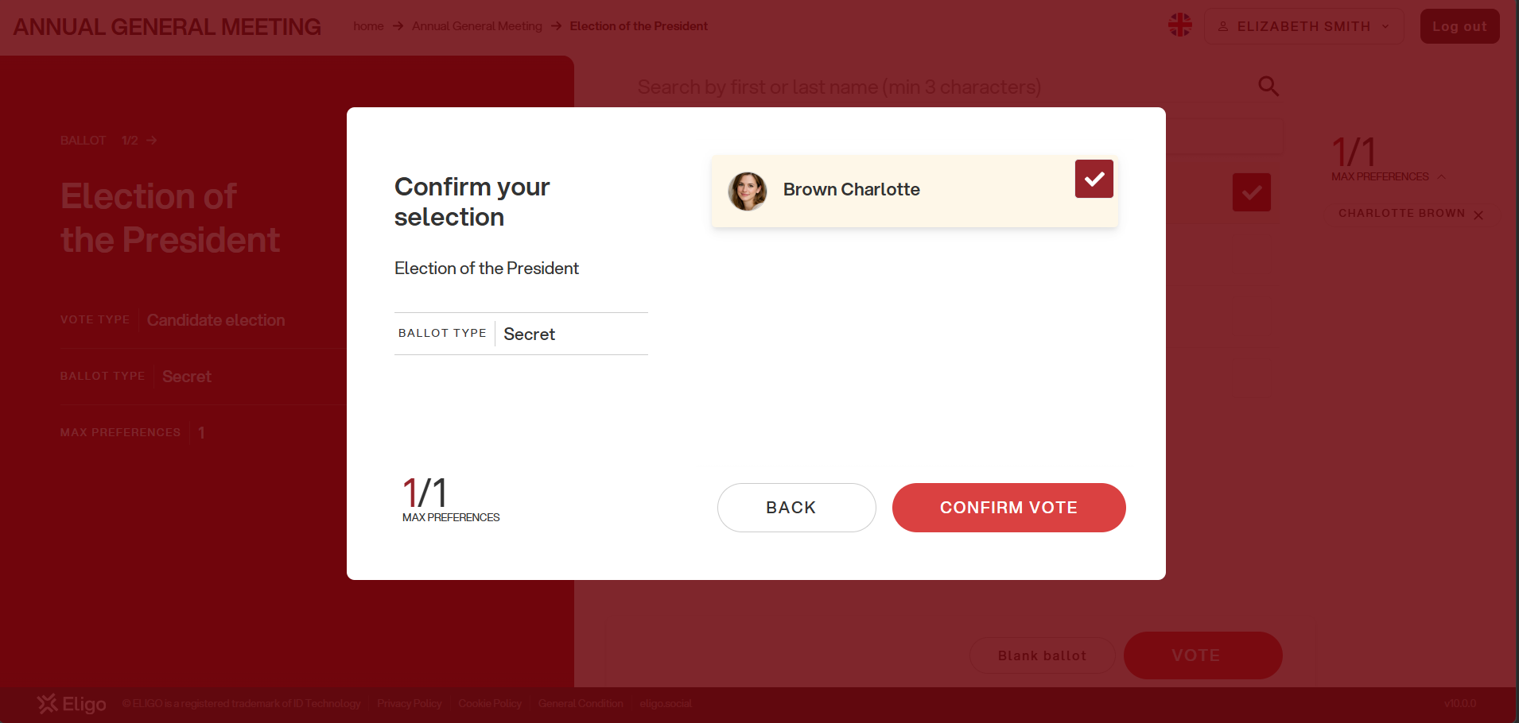
Review the summary of your choice
If it is correct, click on “CONFIRM VOTE”

Slide 12
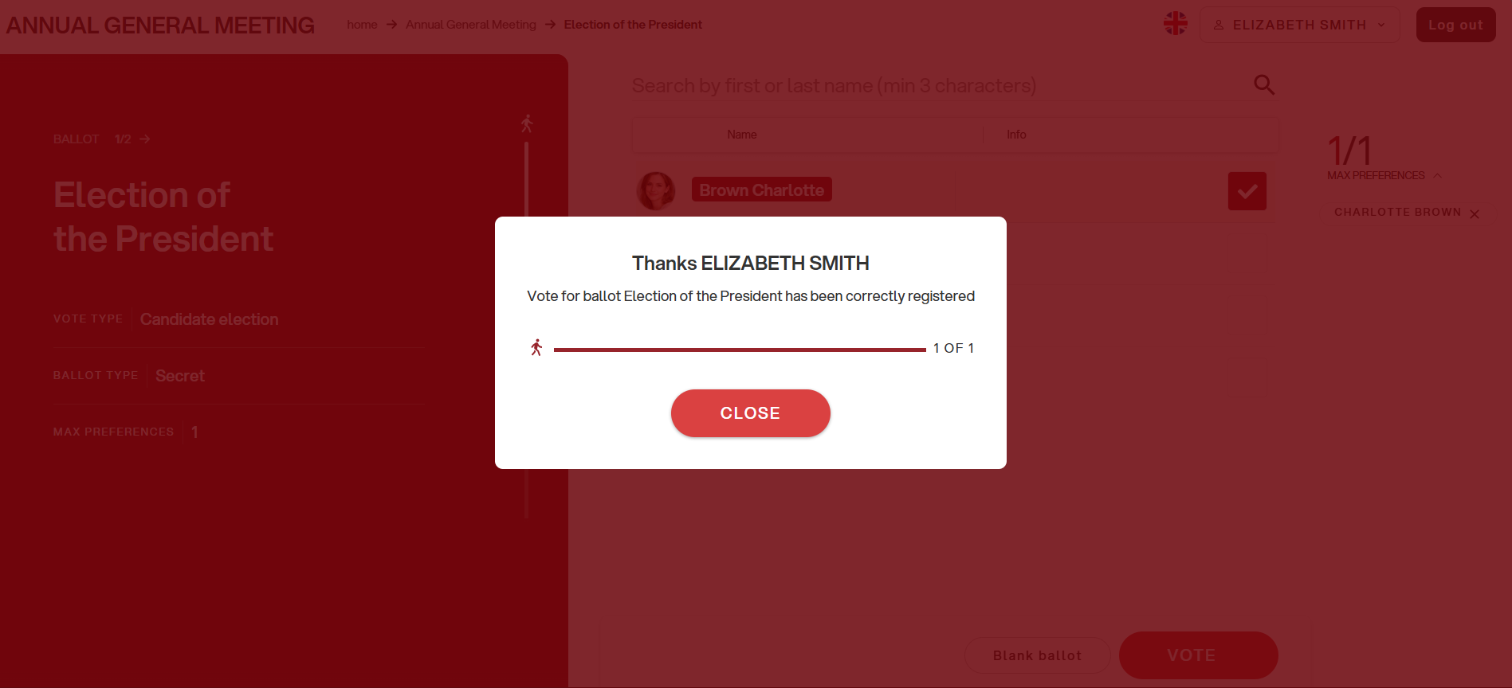
Your vote is securely and definitively placed in the digital ballot box
Click on “CLOSE” to continue

Slide 13
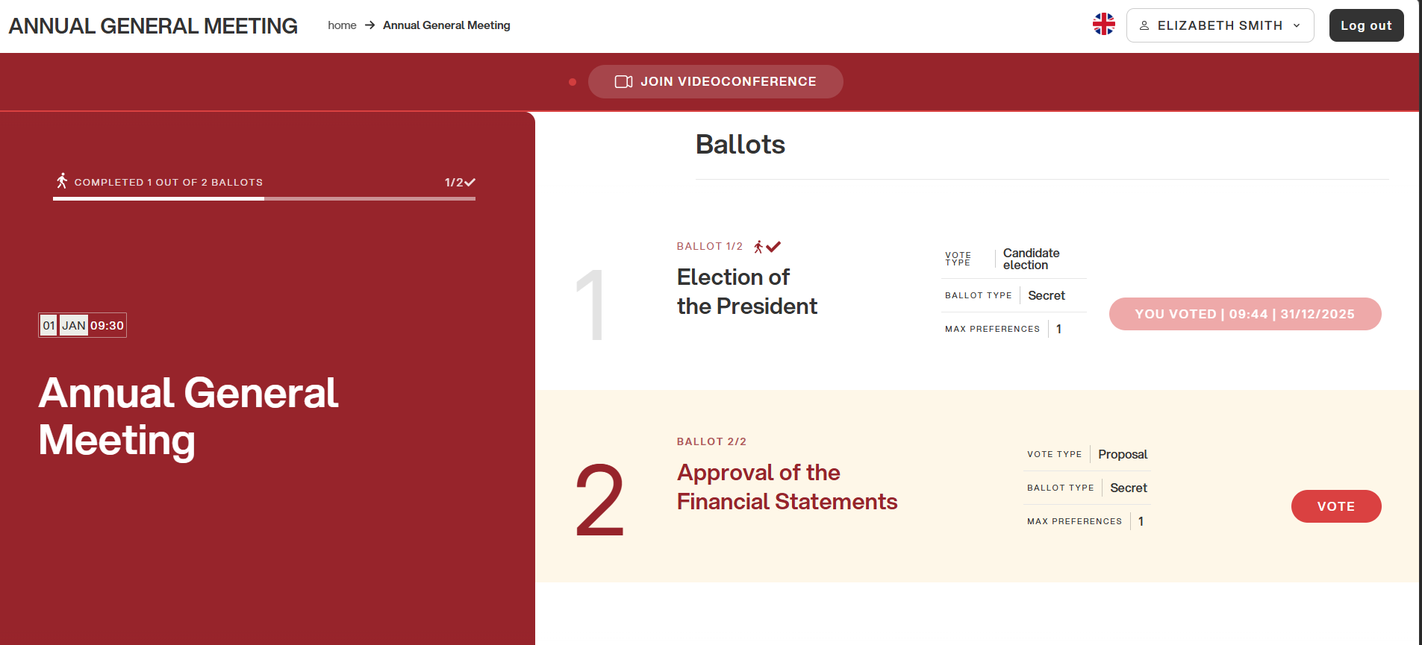
In your voting area, you can see ballots already submitted and those still open
Click on “VOTE” to continue

Slide 14

The online voting platform is provided by Eligo
Thousands of organizations rely on Eligo to manage voting and assemblies,
in-person, online, or hybrid.
Copyright © 2025 ELIGO |ID Technology S.r.l
P.IVA: 11240660156

